Slide 1
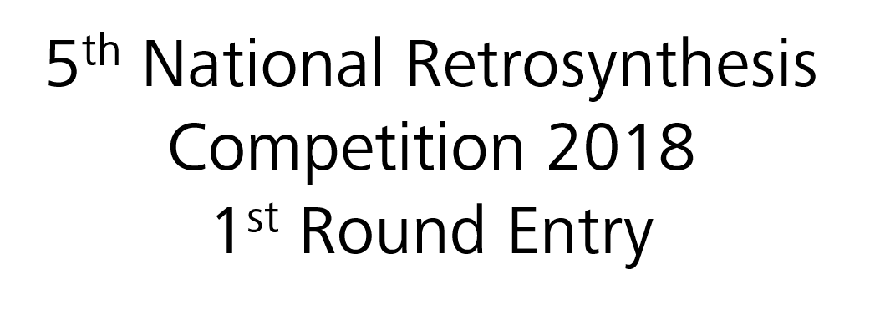
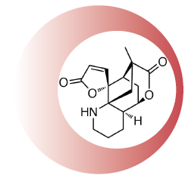

Mannich Black
Tomas Baikstis, Emma Blackham, Matthew Crittall, Ruggero Dondi, Pauline Drouhin, Morgan Jouanneau, James Paliga

Slide 2
Retrosynthesis
Key features of Annotinolide C
Polycyclic 7,8-seco-lycopodane-derived 8,5-lactone architecture
Annotinolide C contains an unprecedented 12-spiro-9,12-γ-lactone moiety
6 contiguous stereogenic centres
Key Steps
Silver-catalysed intramolecular lactonisation via addition of the carboxylic acid to adjacent olefin (B)
Carbon scaffold constructed via a Tandem Ring Closing diEne-Yne Metathesis (RCEYM) (C)
5th National Retrosynthesis Competition - First Round Entry

Slide 3
Retrosynthesis
Key Steps
Substrate controlled copper-catalysed propargylic substitution (D)
Stereoselective double alkylation controlled by 1,3-allylic strain (G)
Asymmetric organocatalytic 1,4-addition (I)
5th National Retrosynthesis Competition - First Round Entry

Slide 4
Forward Synthesis
Organocatalytic Michael addition
Scheme 1. MacMillan’s organocatalytic 1,4 addition ⁽²⁾
Access to the starting furan derivative 1 can be readily achieved in 2 steps from cheap 2-furanone (1 g = £ 5.90 from Sigma Aldrich).⁽¹⁾
Enantioselective organocatalytic Mukaiyama-Michael reaction between furan 1 and aldehyde 2 is expected to proceed with good stereocontrol to afford exclusively butenolide 3, as supported by literature precedent (Scheme 1).⁽²⁾
High regioselectivity is also expected, furnishing solely the 1,4-addition over the 1,6-addition product. This is well supported by the work of Alexakis et al ^{(3a)} and Figueredo et al.^{(3b)}
Mild conditions will be used for the oxidation of aldehyde 3 to the corresponding ester 5 following Studer’s methodology.⁽⁴⁾ Alkylation alpha to the ester group to provide 6 is well precedented and has been shown to proceed with good functional group tolerance.⁽⁵⁾⁽⁶⁾
5th National Retrosynthesis Competition - First Round Entry

Slide 5
Forward Synthesis
1,3-allylic strain
Taking advantage of 1,3-allylic strain, it is envisaged that enolate 8 (inconsequential mix of E and Z isomers) will attack the electrophile di-iodomethane solely from the least hindered face (Figure 1).^{(7a)} Literature precedent indicates good dr ranging from 6:1^{(7b)} to 96:4^{(7c)} for similar examples (Scheme 2). In the discussed case, a higher dr would be expected due to the large size of the electrophile employed.
Cyclisation of 9 is expected to occur exclusively at the ester (1,4-addition into the butenolide is not predicted due to the hard nucleophilic nature of the lithium ion) to provide 5-membered cyclic ketone 10.⁽⁸⁾
Figure 1. Newman projection (R = Et and R¹ = CO₂Me)
Scheme 2. Example of alkylation reaction controlled by 1,3-allylic strain^{(7b)}
5th National Retrosynthesis Competition - First Round Entry

Slide 6
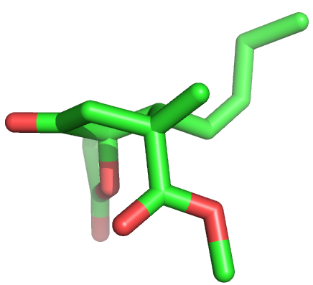
Forward Synthesis
RCEYM precursor synthesis
Nu attack
Favoured (Re)
Scheme 3. Diastereoselective copper-catalysed propargylic substitution^{(9b)}
Grignard addition to ketone 10 and subsequent in situ acetylation will provide ester 11.^{(9a)}
Computational modelling of ketone 10 indicates steric hindrance (by the ester and butenolide moieties) at the bottom face (Si) will direct nucleophilic attack from the top face (Re) (Figure 2).
Subsequent inversion of the (R)-stereocentre will be achieved through a copper-catalysed propargylic substitution reaction (via planar copper allenylidene species 12).^{(9b,c)} This will provide the desired amine 13 as the (S)-epimer (Scheme 3).
Nu attack
Disfavoured (Si)
Figure 2. Computational model of ketone intermediate 10⁽¹⁰⁾
5th National Retrosynthesis Competition - First Round Entry

Slide 7
Forward Synthesis
RCEYM reaction
Scheme 4. Application of RCEYM in the total synthesis of Erythrocarine^{(11b)}
Tandem diene-yne ring closing metathesis of 13 (aided by the Thorpe-Ingold effect) is envisaged to provide cyclised compound 14.^{(11a)}
Formation of the initial ruthenium carbene species 16 will take place exclusively at the terminal alkene, enabling cyclisation to occur first with the adjacent alkyne moiety and then with the internal alkene in a tandem fashion.
The basic nitrogen is protonated to maintain catalyst activity as reported in the total synthesis of Erythrocarine (Scheme 4).^{(11b)}
Selective demethylation using Nicolaou’s conditions will provide access to carboxylic acid intermediate 15.⁽¹²⁾
5th National Retrosynthesis Competition - First Round Entry

Slide 8
Forward Synthesis
End game
Silver(I) triflate catalysed intramolecular addition of the carboxylic acid of 15 to the adjacent olefin will give access to the corresponding bridged lactone 19, as reported by Yang at al (Scheme 5).⁽¹³⁾ Although silver (I) can coordinate to both alkenes of the diene system, only coordination to the alkene adjacent to the carboxylic acid (intermediate 18) can result in cyclisation. Cyclisation is expected to provide 6-membered lactone 19 exclusively, as this allows the reacting cyclohexene ring to adopt a chair conformation (as in accordance with the Fürst-Plattner rule).
Alternative methods to form lactone 19 could be employed at this stage, including iodolactonisation^{(14a)} and Co-mediated cyclisation.^{(14b)}
Finally, reduction of diene 19 is predicted to be both stereo- and regioselective for the more electron rich alkene as reported in the literature (Scheme 6).⁽¹⁵⁾ We are expecting hydrogenation to occur at the least hindered face resulting in a thermodynamically more stable trans-decahydroquinoline system.
Scheme 5. Formation of the lactone intermediate⁽¹³⁾
Scheme 6. Selective alkene reduction⁽¹⁵⁾
5th National Retrosynthesis Competition - First Round Entry

Slide 9
Summary
We propose a protecting group free synthesis of Annotinolide C in only 11 steps, from literature-precedented starting materials (13 steps from commercial building blocks)
Estimated 20% overall yield
Full stereocontrol of the 6 contiguous stereocentres
Key Steps
An organocatalysed Michael addition to access a single enantiomer of the butenolide moiety in just one step
Stereoselective alkylation controlled by the 1,3-allylic strain present in the molecule
Substrate controlled copper-catalysed propargylic substitution
A tandem dienyne ring closing metathesis to rapidly assemble the core scaffold of the molecule
A silver-catalysed lactonisation to construct the bridging lactone with full regiocontrol
Annotinolide C
5th National Retrosynthesis Competition - First Round Entry

Slide 10
References
For the synthesis of furan 1, see: a) S. F. Martin and S. K. Bur, Tetrahedron Lett., 1997, 38, 7641-7644 [10.1016/S0040-4039(97)10080-6]; b) S. Naito, M. Escobar, P. R. Kym, S. Liras, S. F. Martin, J. Org. Chem., 2002, 67, 4200-4208 [10.1021/jo011157s].
For MacMillan’s organocatalytic 1,4-addition, see: a) S. P. Brown, N. C. Goodwin and D. W. C. MacMillan, J. Am. Chem. Soc., 2003, 125, 1192-1194 [10.1021/ja029095q].
For example of 1,4-addition into 2,4-dienal, see: a) A. Quintard, A. Lefranc and A. Alexakis, Org. Lett., 2011, 13, 1540-1543 [10.1021/ol200235j]; b) J. Alonso-Fernández, C. Benaiges, E. Casas, R. Alibés, P. Bayón, F. Busqué, Á. Álvarez-Larena and M. Figueredo, Tetrahedron, 2016, 72, 3500-3524 [10.1016/j.tet.2016.04.077].
For oxidation of aldehyde 3 to ester 5, see: S. De Sarkar, S. Grimme, and A. Studer, J. Am. Chem. Soc., 2010, 132, 1190-1191 [10.1021/ja910540j]
For methylation reaction example, see: P. Wipf, S. R. Rector and H. Takahashi, J. Am. Chem. Soc., 2002, 124, 14848-14849 [10.1021/ja028603t].
For iodomethylation reaction example, see: C. B. Rauhut, V. A. Vu, F. F. Fleming and P. Knochel, Org. Lett., 2008, 10, 1187-1189 [10.1021/ol8000987].
For insight into diastereocontrol from 1,3-allylic strain, see: a) R. W. Hoffmann, Chem. Rev., 1989, 89, 1841-1860 [10.1021/cr00098a009]; b) F. F. Fleming, W. Liu, S. Ghosh and O. W. Steward, J. Org. Chem., 2008, 73, 2803-2810 [10.1021/jo702681e]; c) A. C. Spivey, L. Shukla and J. F. Hayler, Org. Lett., 2007, 9, 891-894 [10.1021/ol070011y].
For cyclisation to cyclopentanone 10, see: D. Kim and Y. K. Lee, Tetrahedron Lett., 1991, 32, 6885-6886 [10.1016/0040-4039(91)80434-8].
For similar examples of Grignard addition and propargylic substitution, see: a) M. J. Ardolino and J. P. Morken, J. Am. Chem. Soc., 2012, 134, 8770–8773 [10.1021/ja302329f]; b) T. Johnson and D. Siegel, Bioorg. Med. Chem. Lett., 2014, 24, 3512-3515 [10.1016/j.bmcl.2014.05.060]. For mechanism relating to copper-mediated propargylic substitution, see: c) R. J. Detz, Z. Abiri, R. le Griel, H. Hiemstra and J. H. van Maarseveen, Chem. Eur. J., 2011, 17, 5921-5930 [10.1002/chem.201003727].
Computational modelling details: from Spartan: Restricted Hartree-Fock SCF calculation using Pulay DIIS + Geometric Direct Minimisation, Basic set: 6-31G (D); Number of shells: 116; Number of basic functions: 336; Multiplicity: 1.
For tandem RCEYM to diene 14, see: a) S.-H. Kim, N. Bowden and R. H. Grubbs, J. Am. Chem. Soc., 1994, 116, 10801-10802 [10.1021/ja00102a062]; For the application of tandem RCEYM in natural product synthesis, see: b) K. Shimizu, M. Takimoto, Y. Sato and M. Mori, J. Organomet. Chem., 2006, 691, 5466-5475 [10.1016/j.jorganchem.2006.08.013].
For selective demethylation of ester 14 to carboxylic acid 15, see: K. C. Nicolaou, A. A. Estrada, M. Zak, S. H. Lee and B. S. Safina, Angew. Chem. Int. Ed., 2005, 44, 1378-1382 [10.1002/anie.200462207].
For the silver-mediated lactonisation, see: C.-G. Yang, N. W. Reich, Z. Shi and C. He, Org. Lett., 2005, 7, 4553-4556 [10.1021/ol051065f].
For iodolactonisation example, see: a) M. H. Beale, J. MacMillan and I. K. Makinson, Tetrahedron Lett., 1986, 27, 1109-1112 [10.1016/S0040-4039(86)80062-4]. For the cobalt mediated lactonisation, see: b) H. Shigehisa, M. Hayashi, H. Ohkawa, T. Suzuki, H. Okayasu, M. Mukai, A. Yamazaki, R. Kawai, H. Kikuchi, Y. Satoh, A. Fukuyama, and K. Hiroya, J. Am. Chem. Soc., 2016, 138, 10597−10604 [10.1021/jacs.6b05720].
For reduction of alkene 19, see: a) J. W. Lim, K. H. Kim, B. R. Park and J. N. Kim, Tetrahedron Lett., 2011, 52, 6545-6549 [10.1016/j.tetlet.2011.09.125]; b) Anales de Quimica Int. Ed., 1996, 92, 233.
5th National Retrosynthesis Competition - First Round Entry

